Slide 1
P&AM website
Website:
https://kwh.9u1.net/Services/Paediatrics-And-Adolescent-Medicine.html
2024 09 04

Slide 2


不要
因為此處的banner是有固定的尺寸, 如果不要旁邊的模擬化處理, 則只能拉大圖片 (會導致圖片被裁) 或 左右兩旁顯示白/灰色的顏色以作填充, 以滿足固定的尺寸比例

Slide 3
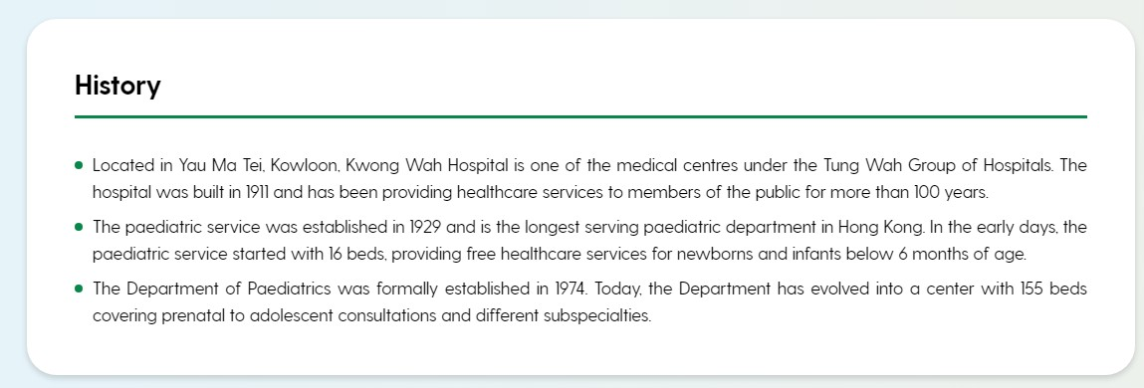
OK

Slide 4
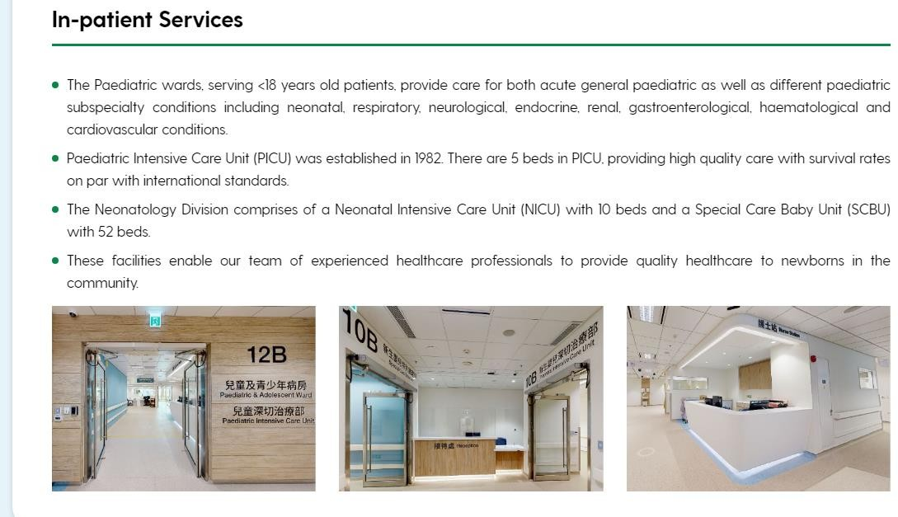
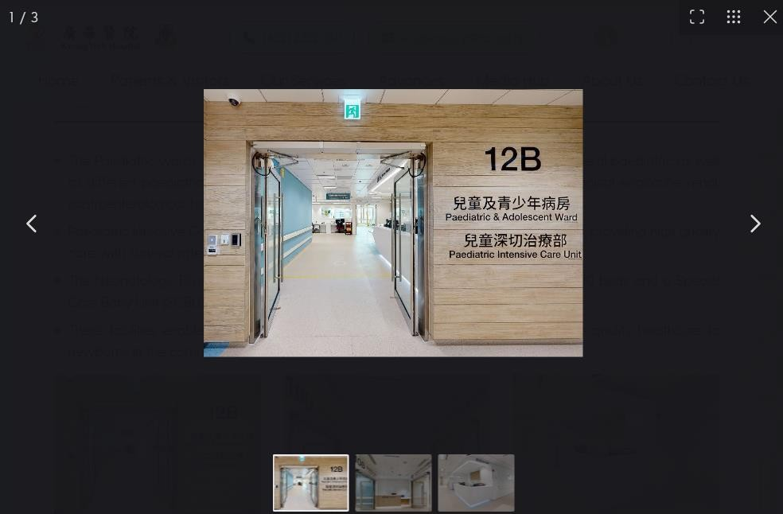
When more than 1 photos, the layout will be as below. Any comments?
不要slideshow功能
Layout OK
Slideshow功能是整個網站統一, 不能個別去除

Slide 5
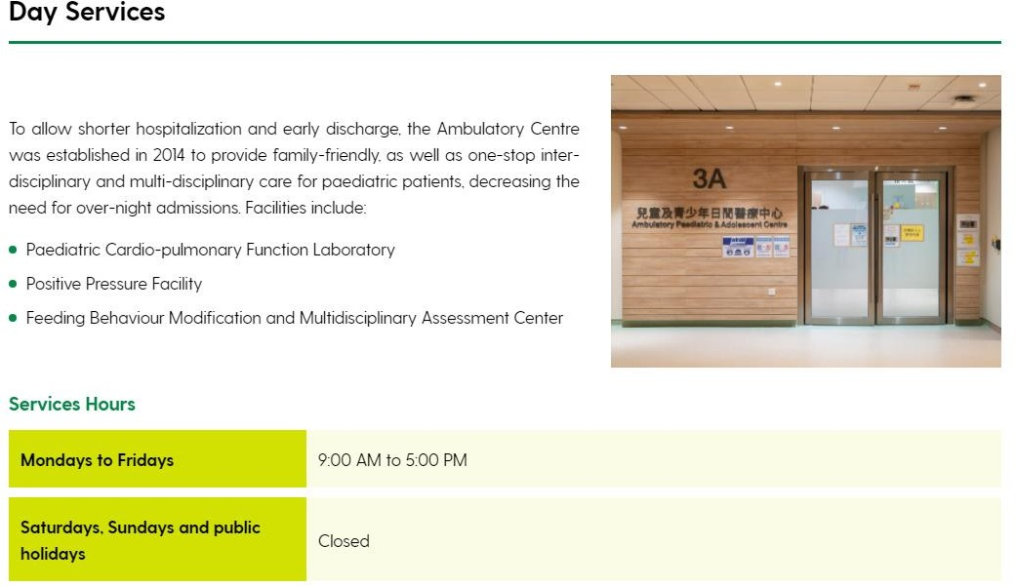
OK

Slide 6
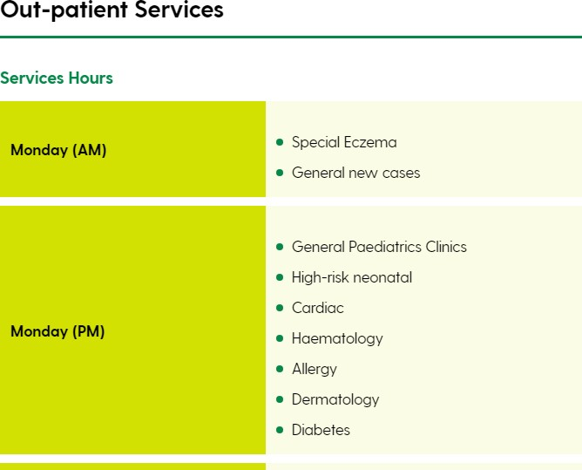
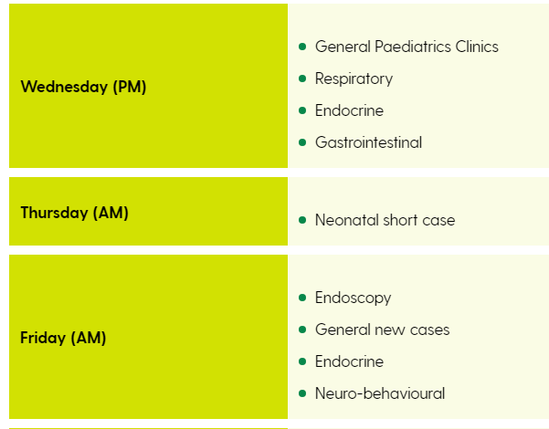
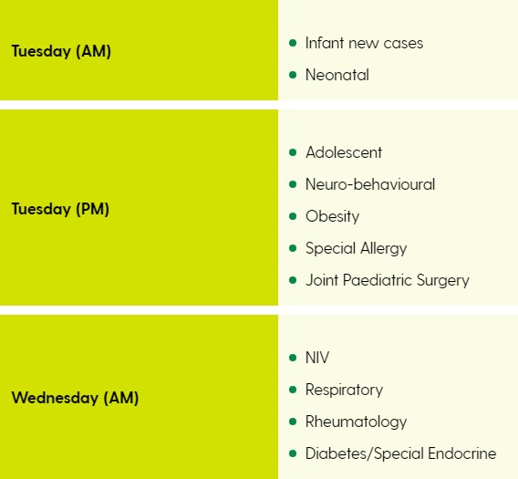
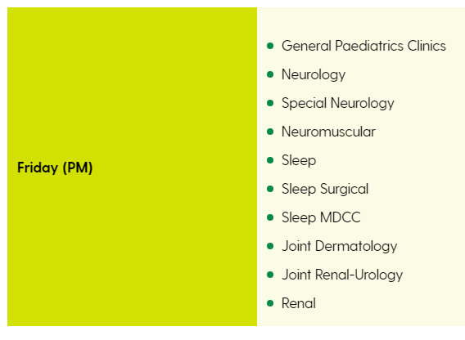
OK

Slide 7

OK

Slide 8
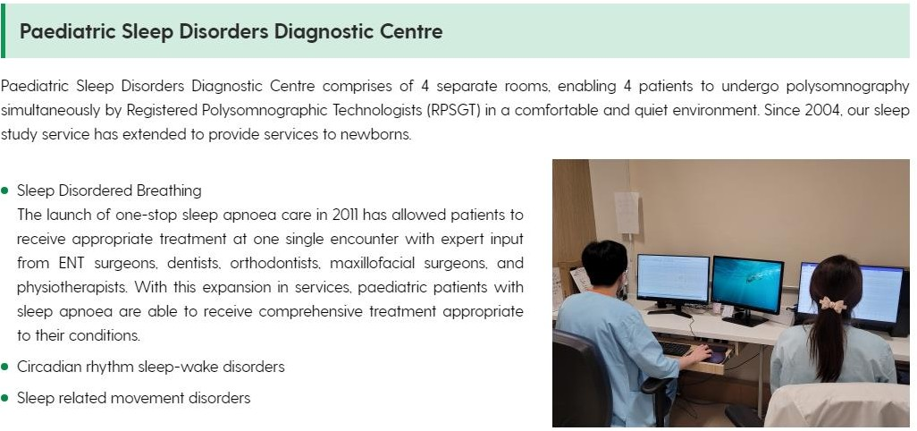
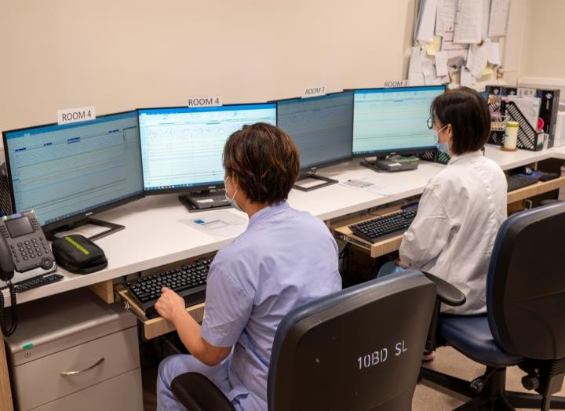
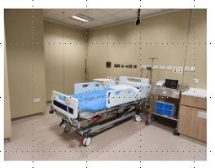
錯相片
之前張相, 不見了??

Slide 9
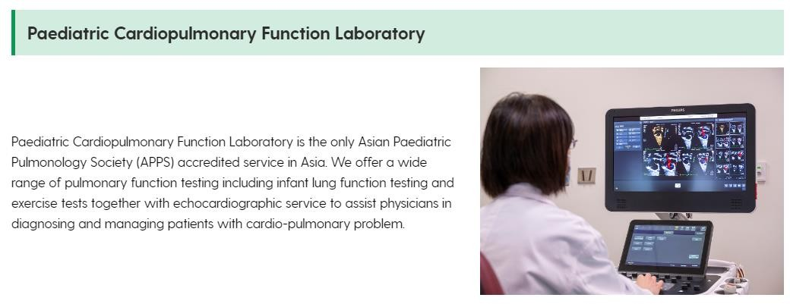
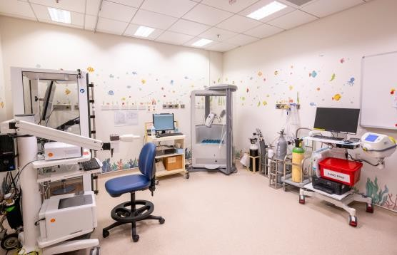
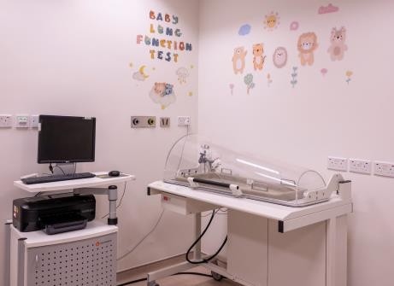
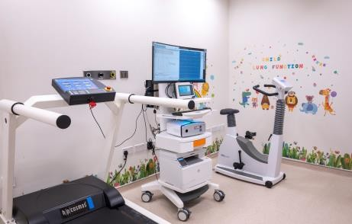
加3張相

Slide 10
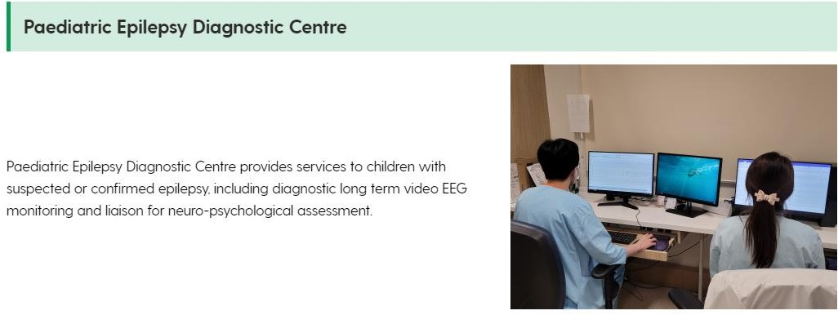
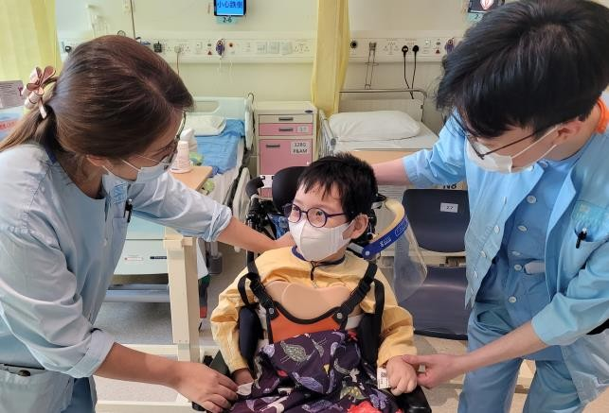
加1張相
(已有病人同意書)

Slide 11
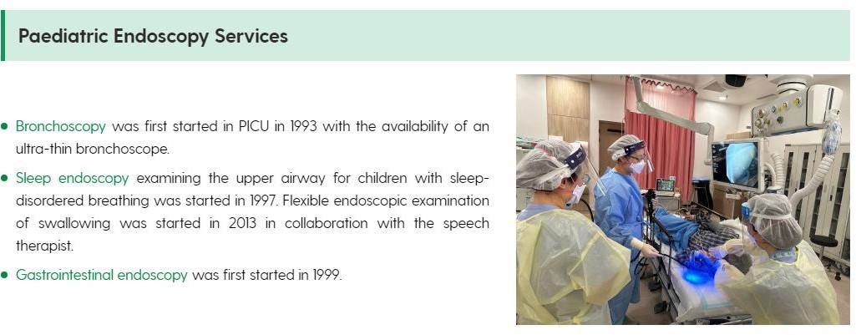
OK

Slide 12
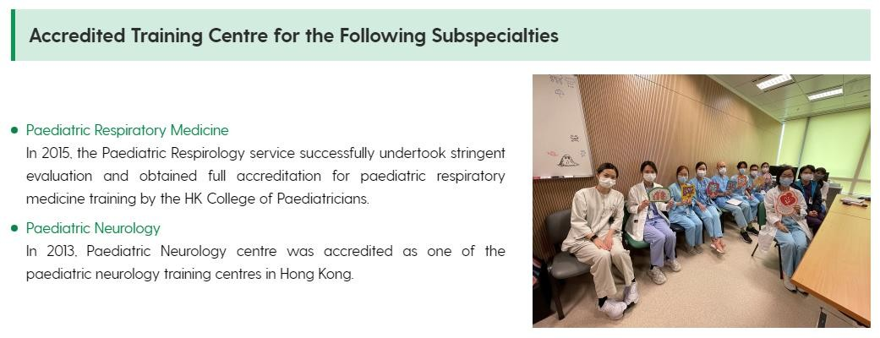
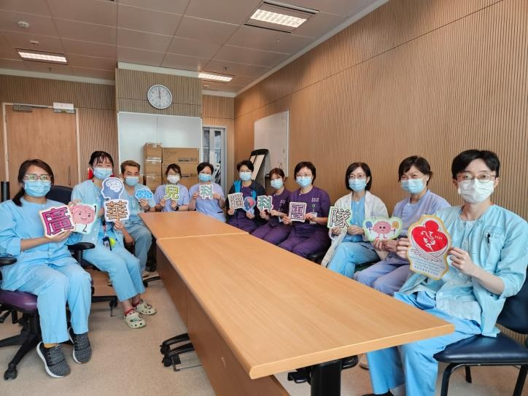
加相 (Neurology team)
(Resp. team)

Slide 13
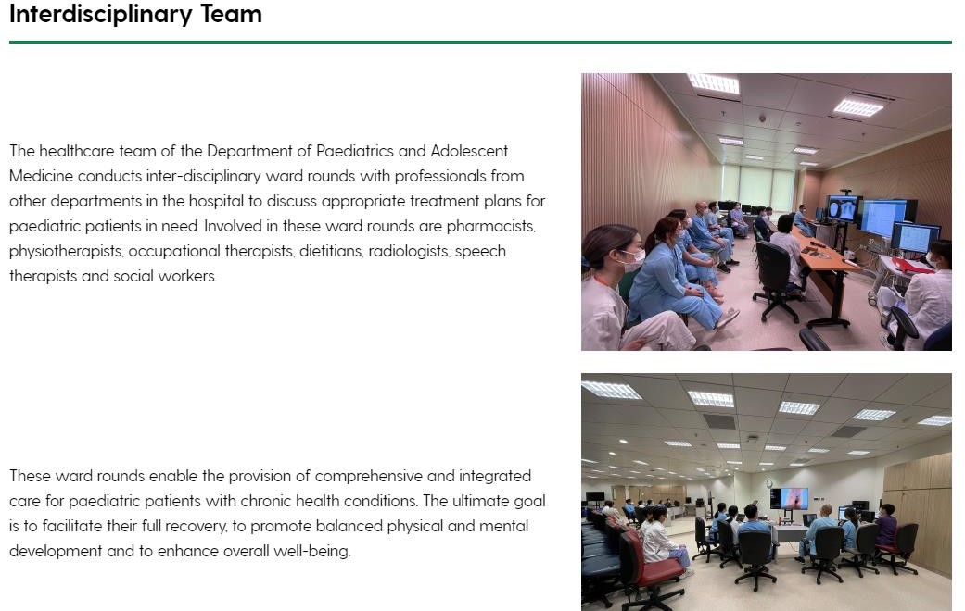
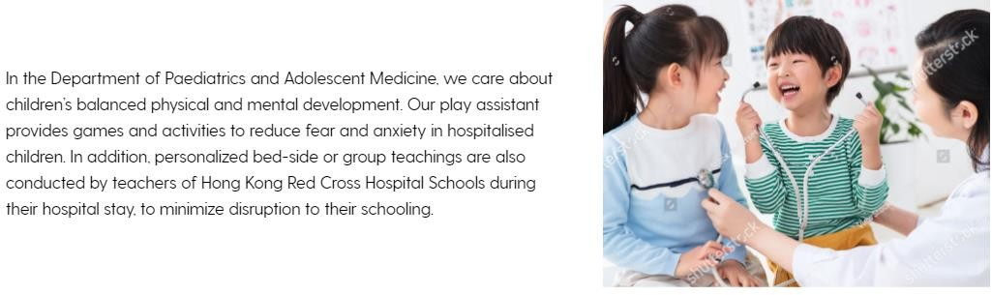
Please confirm whether the photo with watermark is selected to use. If confirmed, the photo will be purchased.
不要

Slide 14
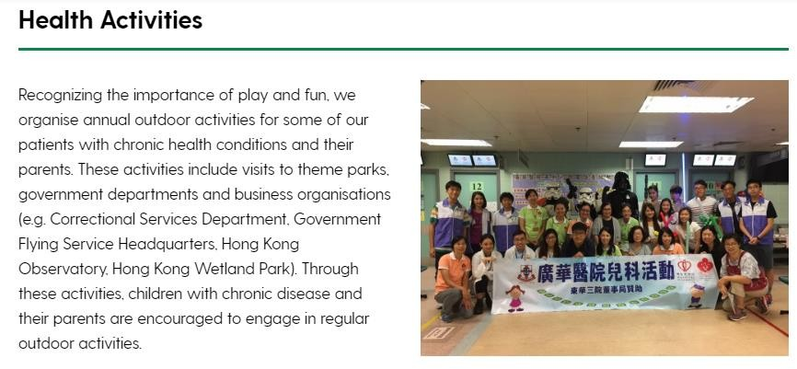
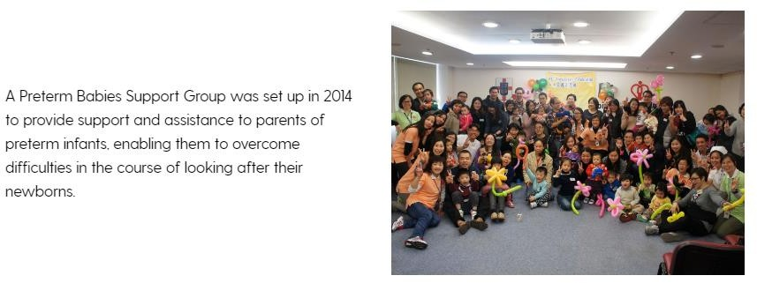
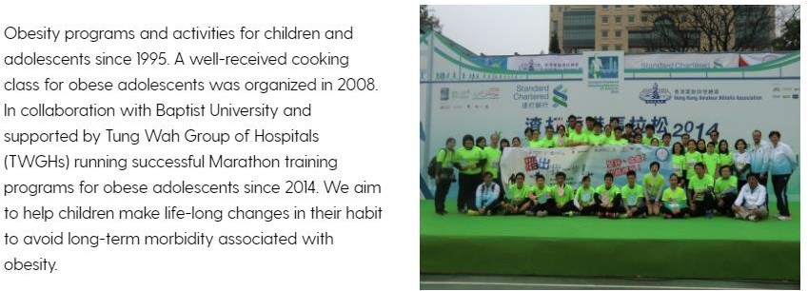

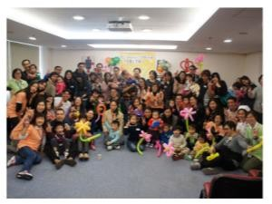
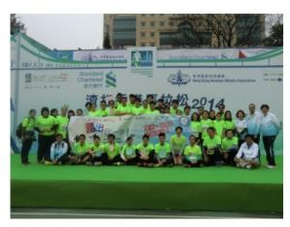
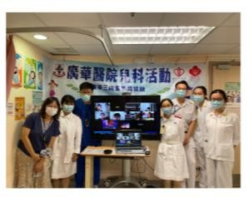
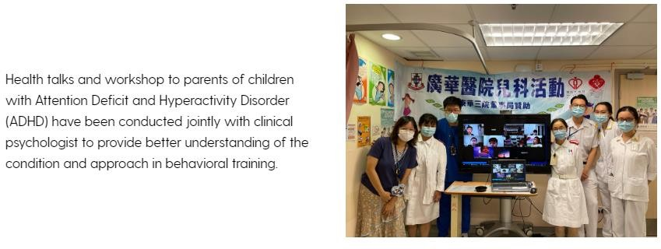
相放最下、盡細、不要看到參加者
Health Activities
Recognizing the importance of play and fun, we organise annual outdoor activities for some of our patients with chronic health conditions and their parents. These activities include visits to theme parks, government departments and business organisations (e.g. Correctional Services Department, Government Flying Service Headquarters, Hong Kong Observatory, Hong Kong Wetland Park). Through these activities, children with chronic disease and their parents are encouraged to engage in regular outdoor activities.
A Preterm Babies Support Group was set up in 2014 to provide support and assistance to parents of
preterm infants, enabling them to overcome difficulties in the course of looking after their newborns.
Obesity programs and activities for children and adolescents since 1995. A well-received cooking class for obese adolescents was organized in 2008. In collaboration with Baptist University and supported by Tung Wah Group of Hospitals (TWGHs) running successful Marathon training programs for obese adolescents since 2014. We aim to help children make life-long changes in their habit to avoid long-term morbidity associated with obesity.
Health talks and workshop to parents of children with Attention Deficit and Hyperactivity Disorder (ADHD) have been conducted jointly with clinical psychologist to provide better understanding of the condition and approach in behavioral training.
Slideshow功能是整個網站統一, 不能個別去除

Slide 15
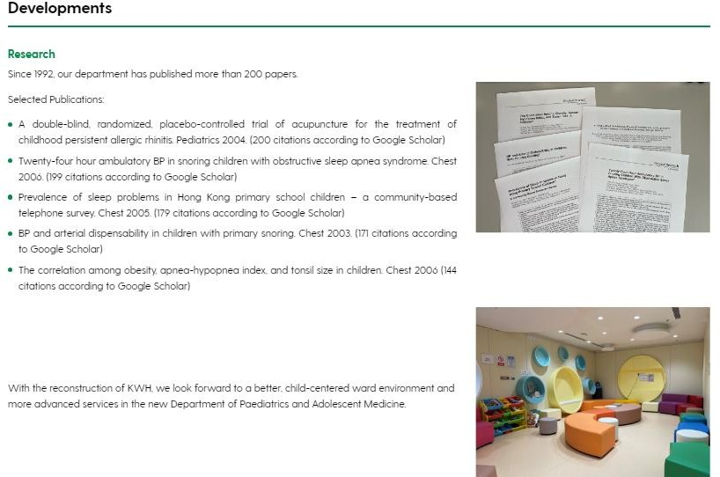
OK

Slide 16
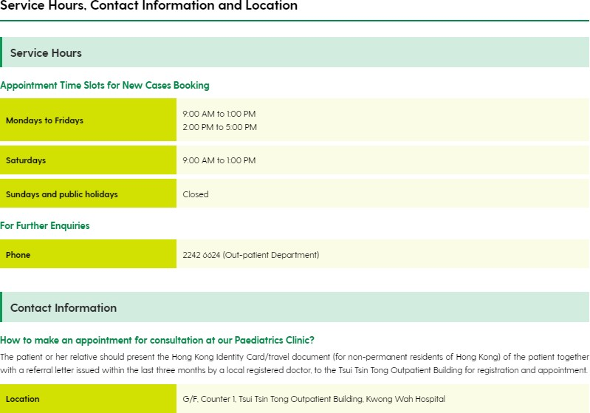
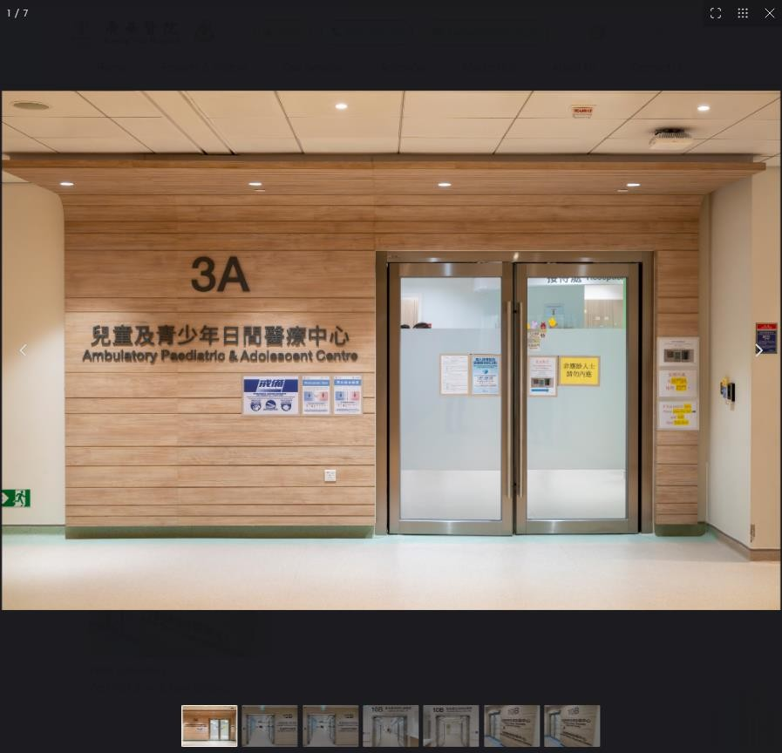
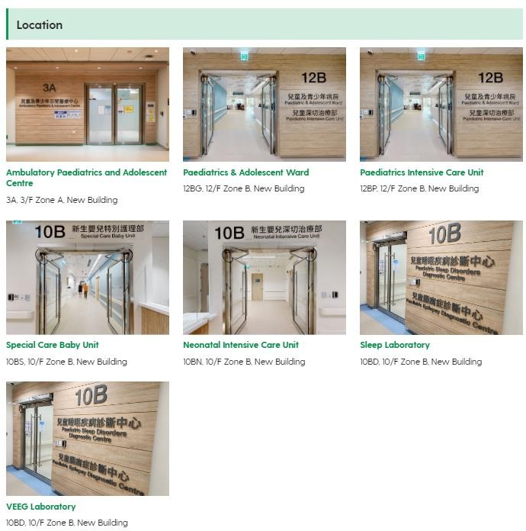
不要slideshow功能
Slideshow功能是整個網站統一, 不能個別去除

Slide 17
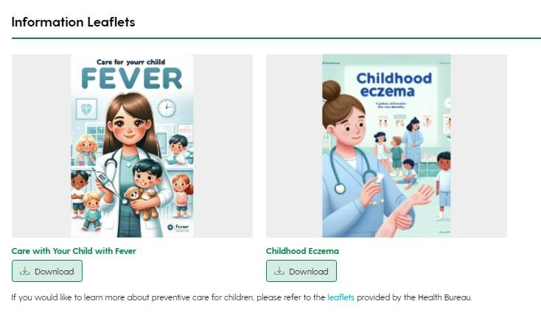
of the Information Leaflets.
Please confirm the cover picture
OK
Leaflets 改用這些:
Eczema-Childhood Eczema_EN.pdf Eczema-Childhood Eczema_CN.pdf
HA_Care of Your Child with Fever_EN_V3.pdf
HA_Care of Your Child with Fever_CN_V3.pdf
How many language version will the leaflet(s) and video(s) provide? Eng/
繁/ 簡
只有EN, CN
For the leaflets and video, found that there is only 1 language version (繁) now. Should they be shown and allowed to download in the corresponding language pages only OR show this single language version in all language pages?
For example,
繁體中文leaflets and video be shown only in 繁體中文page. And hide them in other language pages (Eng/ 簡).
繁體中文leaflets and video be shown in all language pages (Eng/ 繁/ 簡).
A

Slide 18

暫時不要video, 因為還沒製作好

